Slide 1

Blackjack simulation analysis

Slide 2
Content
Background
Research question
Black box representation of the system
Simulation required objects and methods
Results
Sensitivity analysis
Conclusion

Slide 3
Background
Friend of mine made 60K+ with blackjack with a logic and method he is using in an online casino. I got the task to check whether his method is sustainable, to verify it is not plain luck.

Slide 4
Research questions
What is the chance of winning following my friend’s playing logic on Unibet?
What is the expected profit per game/in the long run?

Slide 5
Blackjack mechanic
Sample game [input video]

Slide 6
Abstraction: Black box representation
Environmental variables
Card count
Cards on table
Input variables
Bet
Move logic
Blackjack game
Output variables
Result (W/L)
Profit

Slide 7
Requirements
Replicate game mechanics from Unibet
Replicate playing logic
Simulate lots of games
Save outputs

Slide 8
Requirements – level deeper
Replicate game mechanics from Unibet
Deck (number of cards, shuffle card, value)
Card distribution logic
Termination logic (win/loss)
Replicate playing logic
Move selection (hit, stand, double down, split)
Bet selection
Counting cards

Slide 9
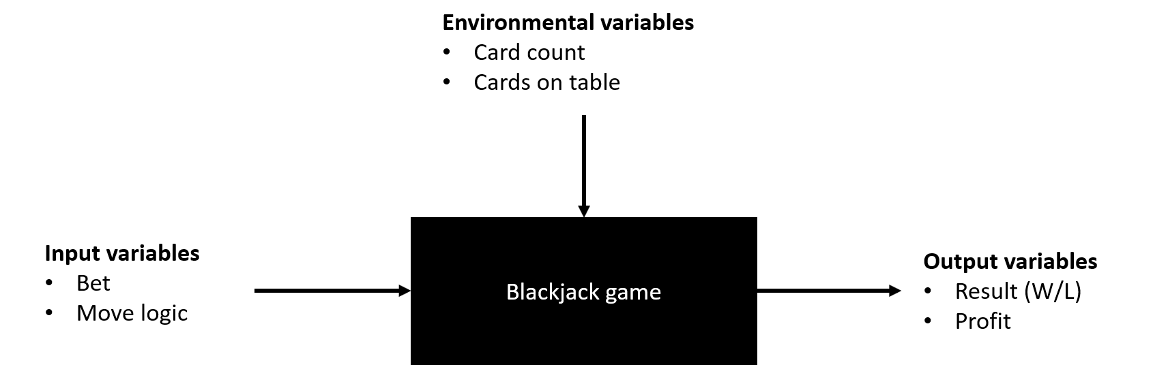
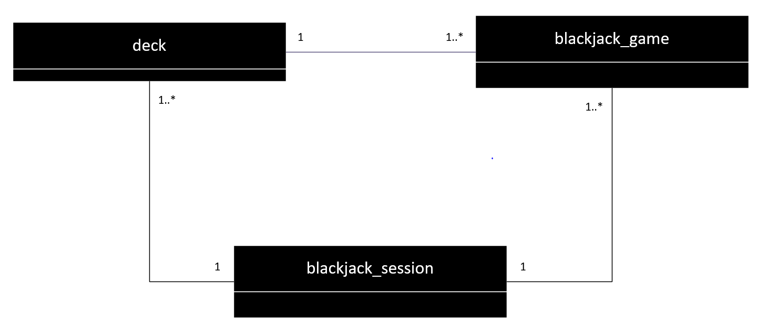
Objects and methods
deck
blackjack_game
blackjack_session

Slide 10
Objects and methods
Methods
deck
initialize
draw card
blackjack
initialize
draw card
compute value
determine next move
split game
open card
calculate result
terminate
play
blackjack_session
initialize
play
compute bet
analyze results
A game of blackjack
Initialize
Play
Draw card & compute value (4x)
Determine next move (>=0x)
Draw card & Compute value (>=0x)
Determine next move (>=0x)
OR:
Split game (1x)
Draw card and Compute value (>=2x)
Determine next move (>=0x)
Open card (1x)
Draw card (>=0x)
Terminate (1x)
A blackjack session
Initialize blackjack session (1x)
Initialize deck (1x)
Play (1x)
Compute bet (<=26x)
Play blackjack game (<=26x)
Reset deck (1x)
Repeat 3.1, 3.2 and 3.3 (until desired number of games achieved)
Analyze results

Slide 11
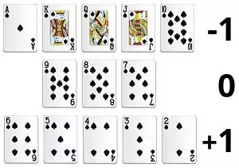
Environmental variables
Card count
Global variable of flipped cards value following this logic:
Cards on table
Attribute of a blackjack game (player_cards, dealer_cards)

Slide 12
Input variables control
Bet computation
Bet magnitude as input of a blackjack session, multiplied by a value depending on card count following logic below:
Card count | Bet multiplier
x<5 | 0
5<x<15 | 1
15<x<25 | 2
 | 3
 | 4

Slide 13
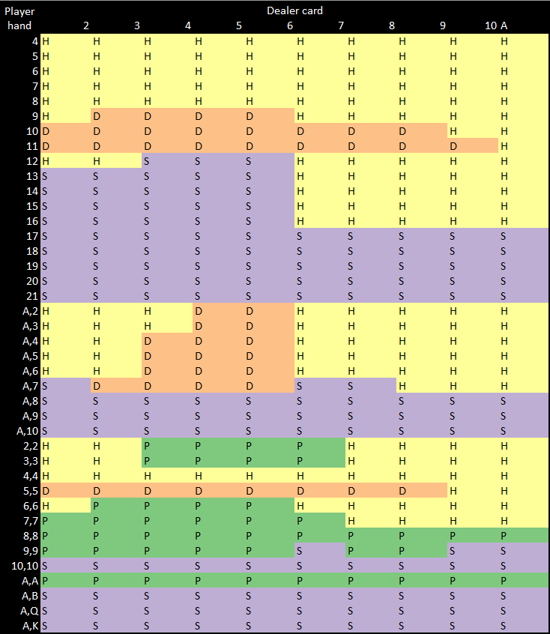
Input variables control
Move logic
To determine the next move, we use move cards depending on the card count.
Card count | Move card
x<5 | low_card
5<x<15 | Medlow_card
15<x<25

Slide 14
Output variables
Result
Calculated when terminating a blackjack game, then stored in a list under the blackjack session.
Profit
Calculated when terminating a blackjack game, then stored in a list under the blackjack session.

Slide 15
Some code

Slide 16
Results

